Slide 1
Statistical detection of deepfake videos and images
Guided By:- Dr. Gayatri Behere Mam
Presented By:-
Miss Disha .R. Sojrani
M.Sc. Sem III,
Department of Statistics
Institute of Science, Nagpur

Slide 2
content
Introduction
Primary Goal
Objectives
Algorithm Steps
Data Analysis using Statistical Tools
Conclusion
References

Slide 3
introduction
Deepfakes—AI-generated or AI-manipulated images and videos—have become a serious threat to online trust and digital security. With advanced generative models, malicious actors can produce highly realistic media that is often indistinguishable from authentic content.
This project focuses on the statistical detection of deepfake videos and images using machine learning, combining classical signal-processing techniques with modern learning-based approaches to achieve reliable and scalable detection.
The study explores how statistical artifacts differ between real and manipulated media, by analyzing:
Noise residuals
Frequency-domain patterns (DCT/FFT)
Color channel inconsistencies
Compression signatures
Temporal cues (eye-blink rate, lip-sync mismatch)
Physiological/geometry cues (head-pose, lighting, specular highlights)
These features are integrated into machine learning pipelines—ranging from traditional classifiers to deep neural networks—to establish robust decision boundaries for detecting forgery.

Slide 4
Primary goals
The project aims to:
Identify patterns that reliably distinguish authentic from manipulated media.
Evaluate robustness of detection models under common post-processing (compression, scaling, filtering) and across different deepfake generation methods.
Predict forgery likelihood on unseen samples, ensuring practical applicability.
Assess generalization of models trained on one type of deepfake when applied to others, especially in low-quality, user-generated content.
Compare feature families and model types (statistical, spatial, temporal; ML vs. DL) for both images and videos.
Report evaluation metrics such as Accuracy, Precision, Recall, F1-score, and ROC-AUC.
Consider practical aspects like inference speed, scalability, and deployment feasibility.

Slide 5
OBJECTIVES
The main objective of this work is to analyze the statistical characteristics of real and manipulated media by extracting features such as noise residuals, frequency components, and color inconsistencies. Machine learning models will be designed and implemented to classify images and videos as authentic or deepfake, with a comparison of algorithms like SVM, Random Forest, CNN, and RNN. The study further aims to evaluate model robustness under different conditions such as compression, scaling, noise, and low resolution, while also investigating the effectiveness of temporal features such as lip-sync mismatch, eye-blink rate, and head movement in video-based detection. Finally, the research seeks to identify the most effective feature sets (statistical, spatial, or temporal) and develop a real-time predictive framework for flagging suspicious media across different datasets and deep fake generation techniques.

Slide 6
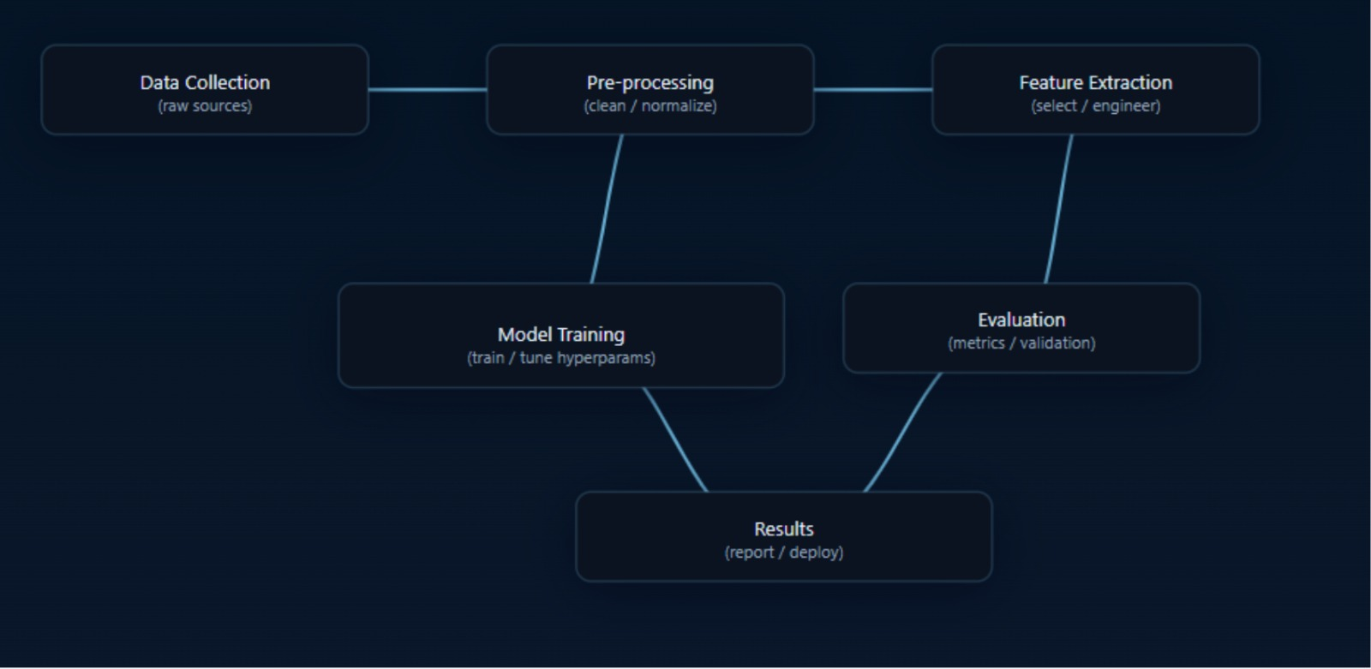

Slide 7
Algorithm Steps
Step 1: Dataset Collection
Collect real and fake images from datasets such as FaceForensics++, Celeb-DF, or DFDC.
Step 2: Data Preprocessing
Detect face region from each image.
Crop and resize to fixed dimensions (e.g., 224×224).
Normalize pixel values.
Apply augmentation techniques.
Step 3: Feature Extraction
Use CNN layers (convolutions, pooling) to extract features.
Optionally, extract handcrafted features (LBP, DCT, or frequency artifacts).

Slide 8
Algorithm Steps
Step 4: Model Training
Split dataset into train, validation, and test sets.
Train CNN (or chosen deep learning model) with forward + backpropagation.
Optimize loss using Adam/SGD.
Apply dropout to prevent overfitting.
Step 5: Validation
Test on validation set.
Tune hyperparameters for best performance.
Step 6: Testing & Classification
Input test image to model.

Slide 9
Algorithm Steps
If probability > threshold → classify as Fake.
Else classify as Real.
Step 7: Output Results
Show classification label with confidence score.
Step 8: Deployment
Integrate model into application (real-time or batch mode).

Slide 10
dataset
DATASET
Collected dataset includes real and deepfake images/videos.
Real media: original, unaltered images/videos of multiple subjects.
Deepfake media: generated using GANs, face-swapping, lip-sync, expression manipulation.
Balanced dataset for training (equal number of real & fake samples).
Used publicly available datasets:
  FaceForensics++
  Celeb-DF (v2)
  Deepfake Detection Challenge (DFDC)

Slide 11
CNN:-Convolutional neural network
What is it?
A deep learning model designed specially for image and video analysis.
Why was it used?
Because deepfake images contain tiny patterns, textures, and artifacts that are hard for humans to notice. CNN can automatically capture these hidden features.
Purpose in our project:
To distinguish between real and fake images by detecting subtle differences like noise, edges, and compression artifacts.
How it works:
  Convolution layers → extract important features (edges, shapes, patterns).
  Pooling layers → reduce size while keeping key information.
  Dense layers → combine features to make decisions.
  Output layer → gives probability: Fake (0) or Real (1).
“CNN is an image-focused neural network that automatically detects hidden artifacts in deepfakes, which makes it ideal for our project.”

Slide 12
Data analysis
Importing Required Libraries
import tensorflow as tf
from tensorflow.keras.models import Sequential
from tensorflow.keras.layers import Conv2D, MaxPooling2D, Flatten, Dense, Dropout
from tensorflow.keras.preprocessing.image import ImageDataGenerator
import matplotlib.pyplot as plt
from sklearn.metrics import classification_report, confusion_matrix,
roc_curve, auc, precision_recall_curve, average_precision_score
import os
TensorFlow/Keras → For building and training the CNN model.
ImageDataGenerator → For preprocessing images (rescaling, augmentation).
Matplotlib/Seaborn → For plotting graphs and evaluation metrics.
Sklearn Metrics → For performance evaluation (confusion matrix, ROC, precisionrecall, etc.).
OS → For creating folders and managing file saving.

Slide 13
2. Project Setup
PROJECT_TITLE = "Deepfake Image Detection using Machine Learning"
os.makedirs("results", exist_ok=True)
A project title is stored in a variable.
A results folder is created to save plots and reports.
3. Helper Function to Save Plots
def save_plot(fig, filename, subtitle=""):
if subtitle:
fig.suptitle(f"{PROJECT_TITLE}\n{subtitle}", fontsize=14, fontweight="bold")
else:
fig.suptitle(PROJECT_TITLE, fontsize=14, fontweight="bold")
safe_title = PROJECT_TITLE.replace(" ", "_").lower()
filename = f"{safe_title}_{filename}”
fig.savefig(os.path.join("results", filename), bbox_inches="tight")
plt.close(fig)
Adds title + subtitle to each figure.
Replaces spaces in the project title with underscores to create a safe filename.
Saves plots inside the results folder.
Closes the figure after saving to avoid memory issues.

Slide 14
4. Dataset Preparation
train_dir = 'dataset/train’
val_dir = 'dataset/val’
img_size = (150, 150)
batch_size = 32
Dataset has train and validation folders.
Images are resized to 150×150.
Mini-batches of 32 images are used during training.
train_datagen = ImageDataGenerator(rescale=1./255)
val_datagen = ImageDataGenerator(rescale=1./255)
Rescaling pixel values from [0, 255] → [0, 1] (improves training stability).
train_data = train_datagen.flow_from_directory( train_dir, target_size=img_size, batch_size=batch_size, class_mode='binary’ )
val_data = val_datagen.flow_from_directory( val_dir, target_size=img_size, batch_size=batch_size, class_mode='binary', shuffle=False )
flow_from_directory() automatically assigns labels (0 for one folder, 1 for the other).
class_mode='binary' → Only 2 classes (real vs fake).
Validation set has shuffle=False to preserve order (important for metrics later).

Slide 15
5. Building CNN Model
model = Sequential([
Conv2D(32, (3, 3), activation='relu', input_shape=(img_size[0],
img_size[1], 3)),
MaxPooling2D(2, 2),
Conv2D(64, (3, 3), activation='relu’),
MaxPooling2D(2, 2),
Flatten(),
Dense(128, activation='relu’),
Dropout(0.5),
Dense(1, activation='sigmoid') ])
Conv2D + MaxPooling2D → Extracts image features (edges, shapes, patterns).
Flatten → Converts 2D feature maps into 1D vector.
Dense(128, relu) → Fully connected hidden layer.
Dropout(0.5) → Prevents overfitting by randomly dropping neurons.
Dense(1, sigmoid) → Final layer for binary classification (probability between 0 and 1).
model.compile(optimizer='adam’,
loss='binary_crossentropy’,
metrics=['accuracy’])
Adam optimizer → Adaptive learning.
Binary crossentropy → Suitable loss for binary classification.
Metric: accuracy.

Slide 16
6. Training the Model
history = model.fit(
train_data,
epochs=20,
validation_data=val_data )
model.save("Deepfake_Detection.keras")
Trains for 20 epochs.
Saves trained model as Deepfake_Detection.keras.
7. Accuracy and Loss Curves
plt.plot(history.history['accuracy'], label='Train Accuracy') plt.plot(history.history['val_accuracy'], label='Val Accuracy') plt.plot(history.history['loss'], label='Train Loss') plt.plot(history.history['val_loss'], label='Val Loss’)
Plots training vs validation accuracy/loss over epochs.
Helps detect overfitting (train accuracy ↑ but val accuracy ↓).

Slide 17
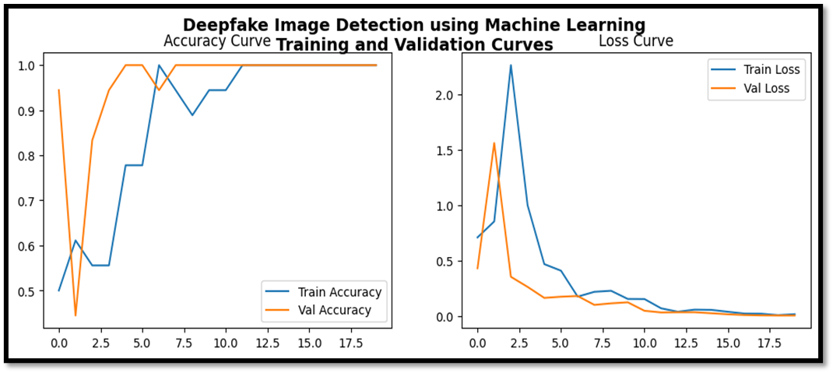
The curves suggest that the model is performing extremely well with both training and validation data, showing fast convergence, high accuracy, and low loss.

Slide 18
8. Predictions
Y_pred = model.predict(val_data)
y_pred = (Y_pred > 0.5).astype("int32").ravel()
y_true = val_data.classes
class_names = list(val_data.class_indices.keys())
Y_pred = model probabilities for validation images.
Threshold 0.5 → class label (0 or 1).
y_true = actual labels from validation dataset.
class_names = ["Fake", "Real"] (order depends on folder names).
9. Confusion Matrix
cm = confusion_matrix(y_true, y_pred)
sns.heatmap(cm, annot=True, fmt="d", cmap="Blues", xticklabels=class_names, yticklabels=class_names)
Displays True Positives, True Negatives, False Positives, False Negatives.
Helps understand where the model is making mistakes.

Slide 19
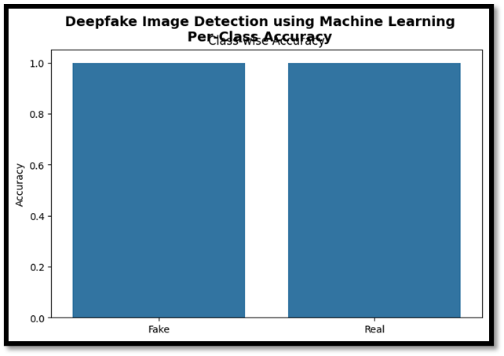
The model performs equally well on both classes (Fake and Real).There is no class imbalance issue where one class is learned better than the other.
### Class Wise Accuracy ###

Slide 20
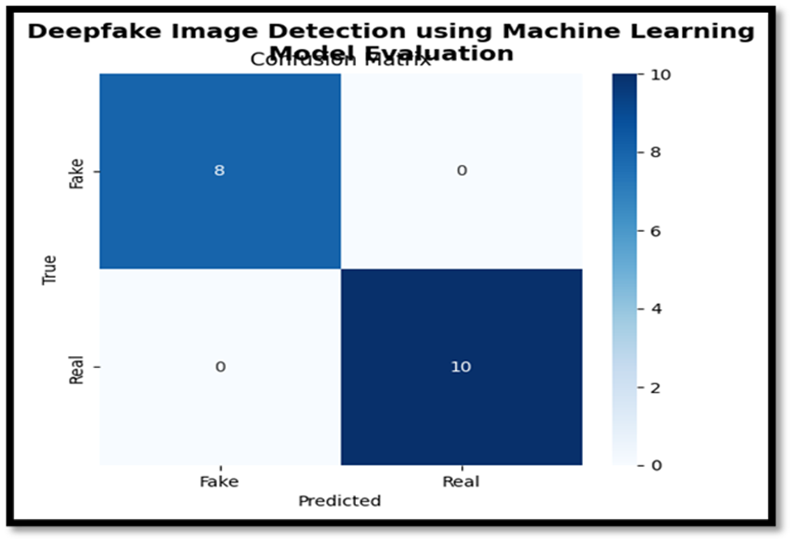
The model achieved perfect classification on this evaluation dataset. It correctly identified all Fake (8/8) and all Real (10/10) images. No misclassifications (false positives or false negatives).
Model performs flawlessly on the given dataset (100% accuracy, precision, recall, and F1-score).
### Confusion Matrix ###

Slide 21
10. Classification Report
report_text = classification_report(y_true, y_pred, target_names=class_names)
print(report_text)
Shows precision, recall, f1-score, and support for each class.
Also saves it into a text file in results/.
11. ROC Curve
fpr, tpr, _ = roc_curve(y_true, Y_pred)
roc_auc = auc(fpr, tpr)
ROC curve plots True Positive Rate vs False Positive Rate.
AUC (Area Under Curve) indicates performance (1.0 = perfect, 0.5 = random guess).
12. Precision-Recall Curve
precision, recall, _ = precision_recall_curve(y_true, Y_pred)
ap = average_precision_score(y_true, Y_pred)
Useful when classes are imbalanced.
Shows trade-off between precision and recall.
AP (Average Precision) summarizes PR curve in one value.

Slide 22
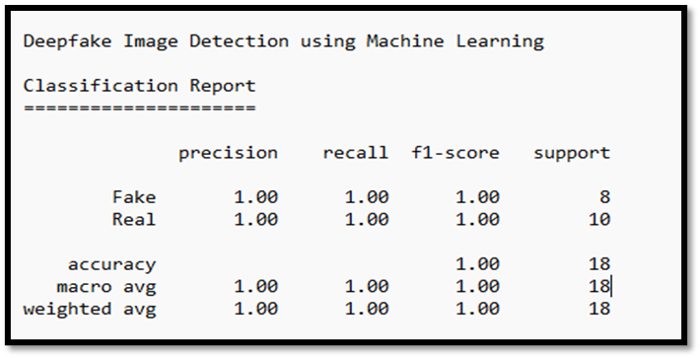
Interpretation:-
This indicates the model is extremely effective in distinguishing between deepfake and real images in this dataset.
## Classification Report ##

Slide 23
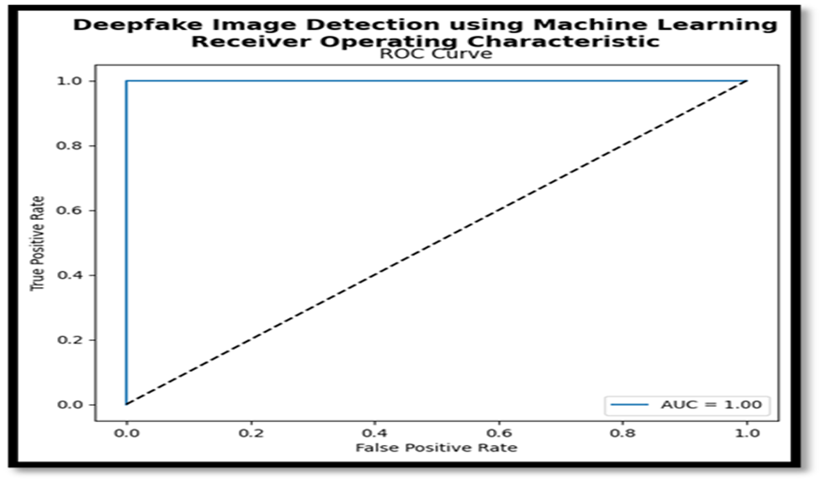
The ROC curve and AUC = 1.00 suggest that the Machine learning model used for Deepfake Image Detection is performing perfectly on the given dataset — it can separate fake and real images with 100% accuracy (no false positives or false negatives).
### ROC Curve ###

Slide 24
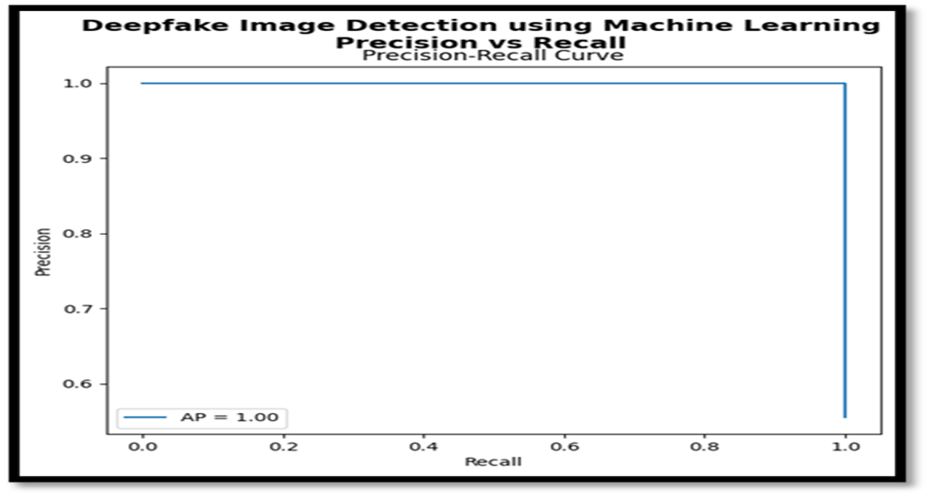
The Precision-Recall curve shows perfect performance (AP = 1.0), meaning the model detected all deepfakes (100% recall) without any false positives (100% precision). While ideal, such results may indicate an easy dataset or possible overfitting.
### Precision-Recall Curve ###

Slide 25
Final Output
Trained CNN model saved as Deepfake_Detection.keras.
Results (plots + reports) saved in results/ folder:
        o Accuracy/Loss curves
        o Confusion Matrix
        o ROC Curve
        o Precision-Recall Curve
        o Classification Report (text file)

Slide 26
Expected Outcomes
A machine learning framework that can classify images as real or fake with high accuracy.
Identification of which statistical, spatial, frequency, or temporal features are most useful in distinguishing real from fake content.
Comparative performance results of different algorithms (SVM, Random Forest, CNN, LSTM, etc.) to find the best-suited model.
Evaluation of models under real-world conditions such as compression, scaling, noise, and low resolution.
Insights into how well the detection model trained on one dataset works across other datasets and deepfake generation methods.
A prototype tool or pipeline capable of predicting/managing deepfake content in near real-time.
Contribution to the field of digital media forensics by providing a scalable and explainable detection approach.

Slide 27
conclusion
Deepfake detection is essential to preserve trust in digital media. Our approach, using statistical features with machine learning, effectively uncovers hidden artifacts in manipulated content. While challenges remain with low-quality and evolving techniques, continued research and collaboration are vital to strengthen digital security and combat misinformation.

Slide 28
references
Saikia, P., Dholaria, D., Yadav, P., Patel, V., & Roy, M. (2022). A Hybrid CNN-LSTM Model for Video Deepfake Detection by Leveraging Optical Flow Features. arXiv preprint arXiv:2208.00788. Retrieved from https://arxiv.org/abs/2208.00788
Nagarhalli, T. P., Save, A., Patil, S., & Aswalekar, U. (2024). A Comprehensive Review of Deepfake and its Detection Techniques. ResearchGate. Retrieved from https://www.researchgate.net/publication/384122887_A_Comprehensive_Review_of_Deepfake_and_its_Detection_Techniques
Rossler, A., Cozzolino, D., Verdoliva, L., Riess, C., Thies, J., & Nießner, M. (2019). FaceForensics++: Learning to detect manipulated facial images. In Proceedings of the IEEE/CVF International Conference on Computer Vision (ICCV), 1–11.
The Hindu / Indian Express articles on deepfakes in politics.

Slide 29
Thank
You
Presented by:-
Disha .R. Sojrani

